Slide 1
The Lisbon Recognition Convention: Outlining the Idea and its Implementation in 50 Countries Allan Bruun Pedersen – Danish Agency for Higher Education and Vice-president of the Lisbon Recognition Convention Committee

Slide 2
The Lisbon Recognition Convention
The Lisbon Recognition Convention (LRC): The only legal text in the European Higher Education Area (EHEA), adopted in 1997
Concerns recognition of access qualifications, periods of study and all higher education qualifications
Once ratified: Valid for all higher education institutions, central recognition authorities and should be implemented in national legislation
Monitored by the LRC Bureau

Slide 3
The Lisbon Recognition Convention: Main principles:
Applicants must have access to fair recognition
Full recognition unless the recognition authority can prove substantial differences between the foreign qualification and a comparable national qualification
Reversed proof of burden
Substantial differences? – in level, profile, workload, quality, profile and learning outcomes of a qualification
Recognition based on comparison of learning outcomes not full equivalence (credit to credit comparison)

Slide 4
The Lisbon Recognition Convention – spirit of the convention
Fair recognition: Not just a question of legal principles and procedures or technical comparisons
Fair recogniton is a culture and a mindset
Fair recognition is also policy

Slide 5
Monitoring of the LRC – carried out by the Lisbon Recognition Convention Committee Bureau
The purpose of the monitoring was to oversee the implementation of provisions determining the obligations of the Parties of the Convention.
What regulated at national level – the implementation of the LRC provisions by national legal acts;
In case of regulation at institutional level (by HEIs), how do the national authorities oversee the internal regulations and oversee the implementation.

Slide 6
Main provisions of the LRC for monitoring
Access to an assessment
Criteria and procedure
Time limit
Right to appeal
Refugees´ qualifications
Information on education system
Information on higher education institutions
National information centre (national ENIC)
Resources to enable the national ENIC to fulfil its functions

Slide 7
Monitoring of LRC
In addition to the monitoring of main provisions of the LRC, the plan was to review:
how do the Parties interpret ‘substantial difference’ and whether there are regulations of the term substantial differences
how the recognition of qualifications held by refugees is translated in national legislation.

Slide 8
Monitoring of LRC
The questionnaire was sent to 53 States Parties to the LRC
Replies were received from 47 countries
Additional 3 countries have answered after the convention meeting in Paris end of February
The monitoring report was published in July 2016

Slide 9
Criteria and procedures
In practice only 28 of the countries (+ 6 partially) surveyed have regulations on the criteria and procedures.
In most cases procedures are regulated in detail but criteria are usually defined at a very general level
4 countries only have detailed regulations governing all the relevant elements: time limit-fee or free - required documents -description of the assessment process -status of report

Slide 10
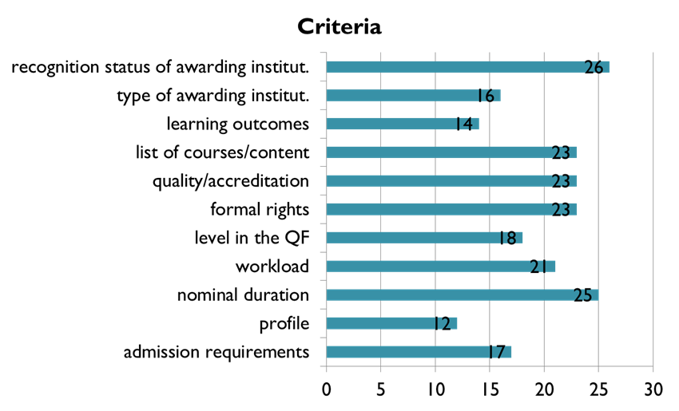
Criteria and procedures

Slide 11
Time limit and appeals
Time limit of assessment is regulated in 33 countries – all within the recommended 4 months time limit – evidence that time limits in most other countries are within the 4 months time limit
Right to appeal is regulated in 38 countries – in many cased the appeal rights refers to code on administrative procedure
Appeal rights not always easy to find on websites

Slide 12
Substantial differences
LRC: Recognition unless substantial difference can be shown
Regulation / definition off substantial differences
National definition – 7 countries
Regulations at institutional level – 4 countries
No definition, no regulations – 39 countries

Slide 13
Considered as a substantial difference
CRITERION | NUMBER OF COUNTRIES
Different access requirements | 27
Nominal duration is shorter by than one year | 32 | Input based
Institution or a programme is not accredited | 49
No final thesis | 18 | Input based
Less requirements for final thesis | 4 | Input based
Differences in programme content / courses | 33 | Input based
Online studies | 12 | Input based
Part-time studies | 6 | Input based
Qualification is awarded by a private institution | 1 | Input based
The programme is not provided in our country | 9 | Input based
Institution is recognised, but is unknown to us | 2 | Input based
Institution is recognised, but is not in the databases | 4 | Input based
Teaching staff qualifications | 3 | Input based

Slide 14
Substantial differences
In many cases, the countries have a relatively common understanding of which criteria may be considered as substantial differences and a reason for partial or non-recognition.
Many countries pointed out, that substantial differences between qualifications does only lead to partial/non-recognition in case the programmes differ on more than one criterion.
Many countries pointed out that substantial differences must be interpreted in the light of the purpose of the recognition. (For example the absence of thesis may not be a substantial difference for employment).
Still a lot emphasis on input based criteria

Slide 15
Refugees qualifications – article 7 of the LRC
An obligation for all parties to the LRC to develop procedures for recognition of refugees for the purpose of access to further studies or employment even in cases in which the qualifications obtained in one of the parties cannot be proven through documentary evidence.
Background paper based on Diploma Supplement

Slide 16
Refugees’ qualifications – article 7
Regulated at national level – 8 countries (1 country has regulation for access qualifications only)
Regulated by competent recognition authorities (national ENIC) – 6 countries
Not regulated – 36 countries

Slide 17
Information on education system
Information on education systems are available online in 48 countries out of 50
10 countries – in national language only
32 countries – in national language and in English
2 countries – in national, English and in other languages
6 countries – in English only (from which 1 country is not English-speaking)

Slide 18
Information on higher education institutions
Information on education systems are available online in 50 countries out of 50
12 countries – in national language only
32 countries – in national language and in English
6 countries – in English only (from which 1 country is not English-speaking)

Slide 19
Conclusions and recommendations from the convention meeting in Paris
Recommended that by the end of 2018, regulations on procedures of refugees´ qualificiations should be implemented: Creation of „background paper“ as a goal for recognition of refugees´ qualifications
Minimum requirements for information on the education system, HEIs and programmes to be included in the online sources
Recognition based qualitative criteria such as learning outcomes and formal rights of qualification instead of nostrification and equivalency
Appeal rights must be clear and in widely spoken language

Slide 20
Conclusions and recommendations
In many respects, the authorities have implemented the principles of the LRC
The implementation is still rather uneven across the Parties and none of the countries have fully implemented the LRC
Little knowledge about the implementaion of LRC in institutional recognition
The national authorities must reflect and take action to secure full implementation of the LRC
Regular monitoring (periodically) of the implementation of the LRC should be undertaken by the LRC Committee

