Slide 1




Land Rights in Ethiopia
By Sayeh Kassaw Agegnehu

Slide 2
Content
Facts
Land
Land tenure systems and tenure security in Ethiopia
Formalizing of property rights
Peri-urban land right challenges
Study stay in Vienna
EduLAND2 – PROJECT 113

Slide 3
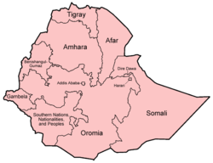
Facts - Ethiopia
Bordered with
  Eritrea, to the north
  Djibouti and Somalia to the east,
  Sudan to the west,
  Kenya to the south.
Population number = 90million, growth rate 2.6% per annum
  Rural 82.6%
  Urban 17.4%
The second in Africa

Slide 4
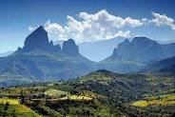
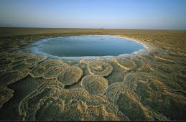
Facts - Ethiopia
Area coverage 1,104,300 km²
  72.2% temporary crop
  6.6% permanent crop
  13.7% grazing and fallow land
  1.4% wood land, and
  6.1% other land use types
Elevation ranges from 136 meters below sea level in the Denakil Depression
to 4620masl at Ethiopia’s highest mountain, Ras Dashen

Slide 5
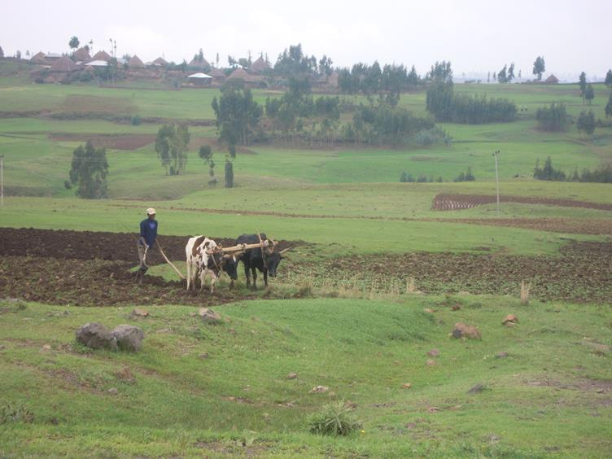
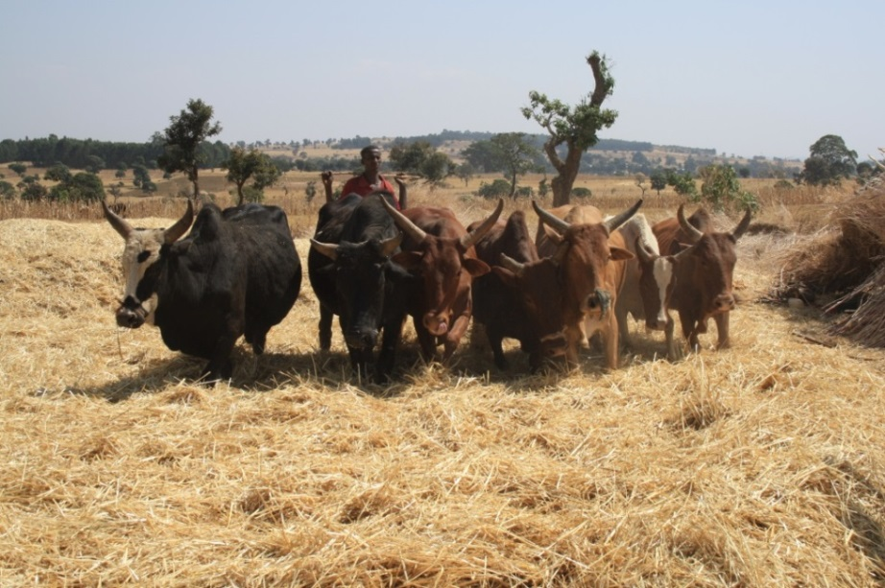
Facts – Ethiopia
GDP = On average 11% increased within the past ten years
In 2012/2013
  Agriculture = 43% share
  Industry = 12% share
  Services = 45%

Slide 6
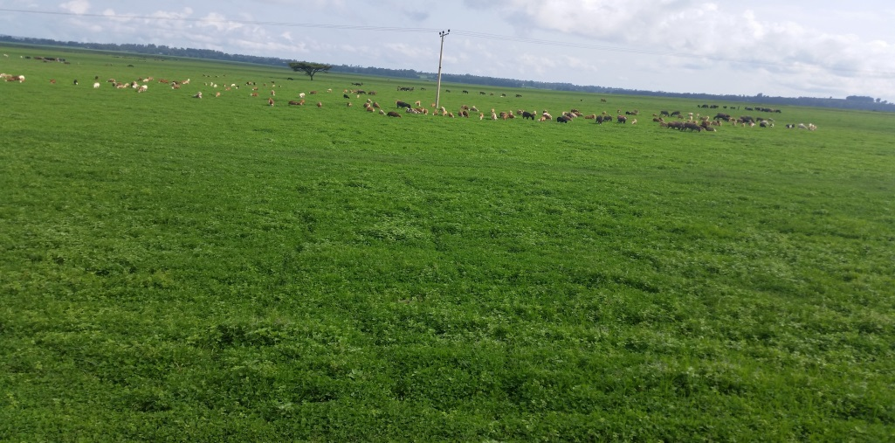
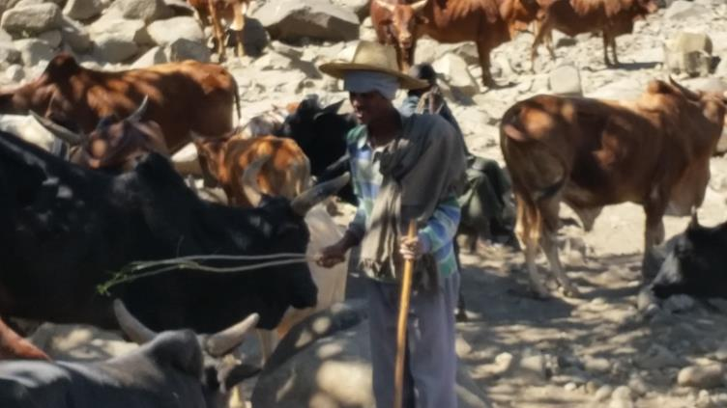
Facts – Ethiopia
The first from Africa and 10th in the world in livestock number
  53.3million cattle
  25.5million sheep
  22.8million goats

Slide 7
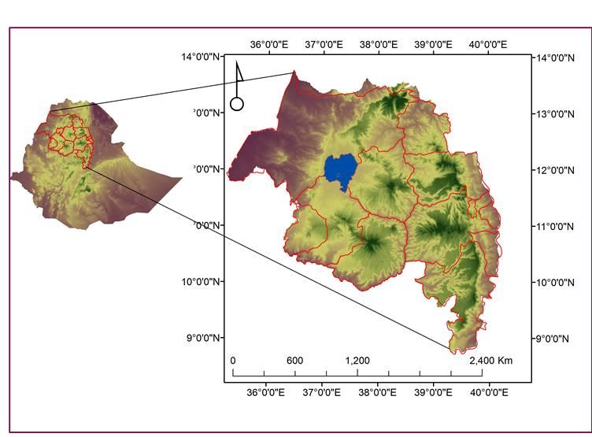
Facts – Ethiopia
9 regional states and 2 city adm
Amhara National Regional State (ANRS)
  Population above 20 million
  171,000km²
  altitudinal 600 – 4620masl
  Ras Dashen – the altitudinal peak is located in this region
  three major agro climatic zones
    Highlands – above 2300masl (22%)
    semi-highlands areas – 1500 – 2300masl (44%)
    Lowlands – below 1500masl (27% )
    7% is assumed to constitute extreme low land and extreme high land areas

Slide 8
Land
Land – basic asset for existence
In developing countries
In Ethiopia:
  offers diversified livelihood opportunities and alternatives
  Wealth to transfers to heirs
  Cultural dimension
Food and shelter
LAND
Legal entity
Land Markets
Physical space
Cultural heritage

Slide 9
Land tenure systems and tenure security in Ethiopia
Ethiopian land tenure systems can seen dividing into three categories
  Pre-1975 land tenure system
  The Derg Era land tenure system
  The current land tenure system
Pre-1975 land tenure system
  Complex
  Rist, Gult, state and church
  Rist/Gult – hereditary and northern part
  In the southern part sharecropping tenants
  Inheritance, gift, lease, sharecropping
  Gult – trustworthy to the regime, ex., royal family members, military.

Slide 10
Land tenure systems and tenure security in Ethiopia
Land tenure system during the Derg Era
  Derg regime overthrew Emperor Haile Selassie
  Followed socialist doctrine
  In 1975 – Public Ownership of Rural Lands Proclamation
  The basic provisions of this proclamation included:
    public ownership of all rural lands,
    distribution of private land to the tiller, and
    prohibitions on transfer of use rights by sale, exchange, succession, mortgage, and lease
  the Rist/Gult imperial land tenure system was abolished

Slide 11
Land tenure systems and tenure security in Ethiopia
  inheritance of land rights – limited scale to spouse or children
  10hectares – maximum landholding
  Tenure security critically challenged
The current land tenure system
  Derg is overthrown and the Ethiopian People’s Revolutionary Democratic Front (EPRDF) came into power
  Land is owned by the government and people of Ethiopia
  Landholders’ right to use their land in perpetuity
  Farmers have right to obtain land without payment and of protection from eviction
  regional governments to administer their land and natural resources

Slide 12
Land tenure systems and tenure security in Ethiopia
Different regions enacted their own land administration proclamation
ANRS - Proclamation 46/2000 , Proclamation 133/2006
Rural land registration and certification launched
The key objective of it is guaranteeing landholding rights and assuring land tenure security
It also enables to get revenue through taxes

Slide 13
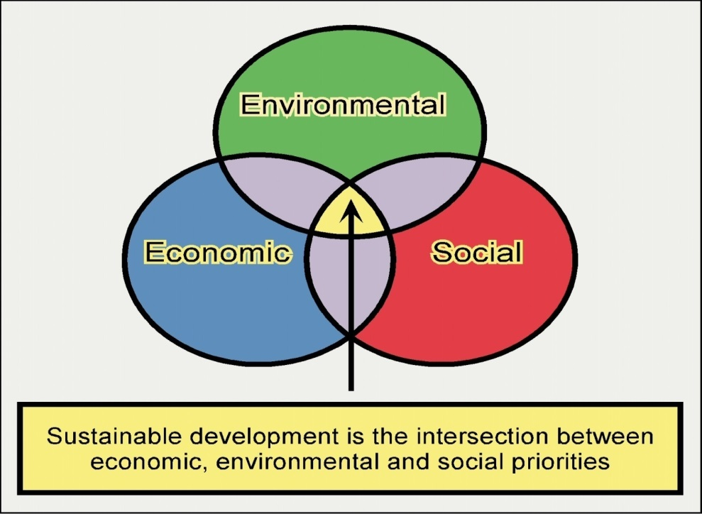
Formalizing of Property rights
Property can be broadly defined as an object to which legal rights (rights of ownership or rights of use) are attached which can be described as bundles of rights
Tenure security ---
  incentives to invest,
  natural resources management,
  reduces poverty,
  social stability,
  encourage good governance
Brings economic development

Slide 14
Formalizing of Property Rights
Some argue that formalization of land rights didn’t bring tenure security in Africa (based on the study conducted in Kenya, Tanzania, Burkina Faso)
  not reduced poverty
  Didn’t bring economic development
Their argument is based on:
  pitfalls of execution
    Titles are not used as collateral
    Lack of investment
    Lack of alienation
  Lack of considering customary rights

Slide 15
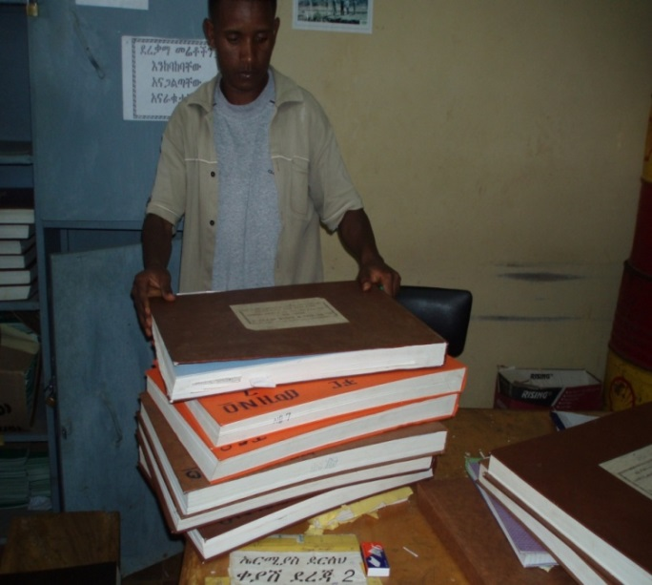
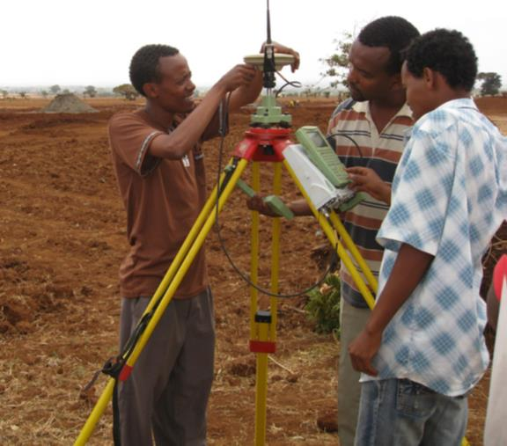
Formalizing of Property Rights
Though contradictory arguments, land titling programs have been exemplified as a means of securing land tenure security
By means of formalizing land rights
Formalizing – to make official the land rights
Formalizing property rights – leads to tenure security
Formalizing land rights is one of the prior agendas

Slide 16
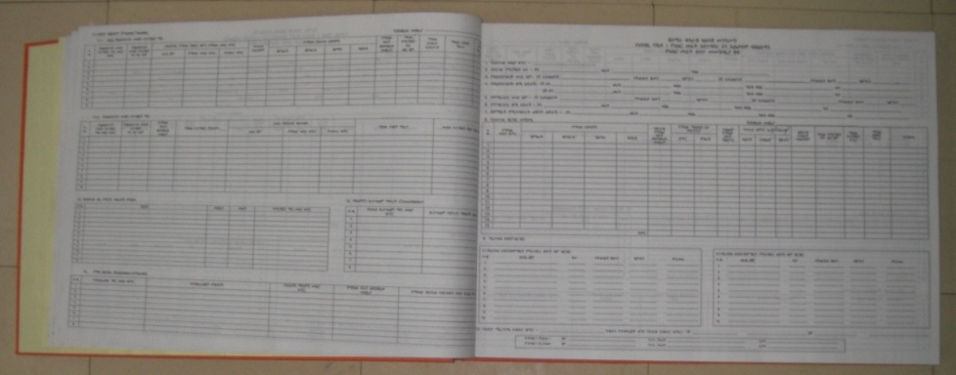

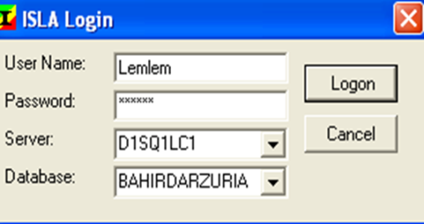
Formalizing of Property Rights
In order to assure land property rights:
  recording of spatial information
  non-spatial information
The information recorded both manually and in digital forms

Slide 17
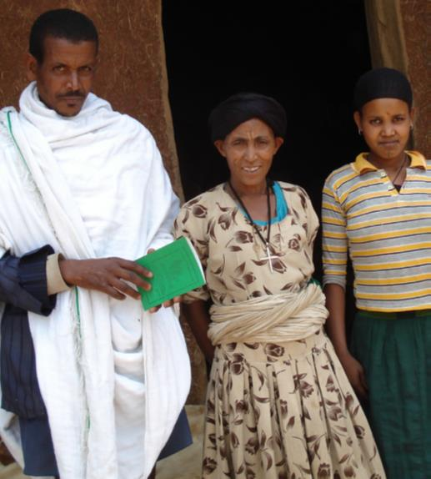
Land tenure systems and tenure security in Ethiopia
Four types of landholdings
  Individual
  Group
  Communal
  State
The registration
  Primary
  Secondary
Certificate is delivered for each landholding type

Slide 18
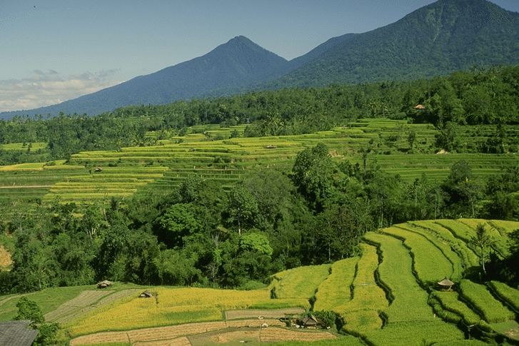
Formalizing of property rights
In Ethiopia, formalizing of land rights created incentives to invest
land registration and certification bringing good incentives in rural areas
But what about in peri-urban areas?
The focus of my study was on peri-urban land rights taking two cities as case study areas

Slide 19
Peri-urban land right challenges
Many United Nation studies indicted that world is urbanizing rapidly
In mid of 2009, urban population number surpassed rural population number
In the 20th century – urbanization was high in developed world
The current trend is in developing countries
Sub-Saharan countries --- the largest rate of urbanization
East African were considered as least urbanized but currently high urbanization rate
high pressure to peri-urban land
Because both public and private institutions focus on peri-urban areas for land
For instance, if we take the case of Debre Markos town peri-urban

Slide 20
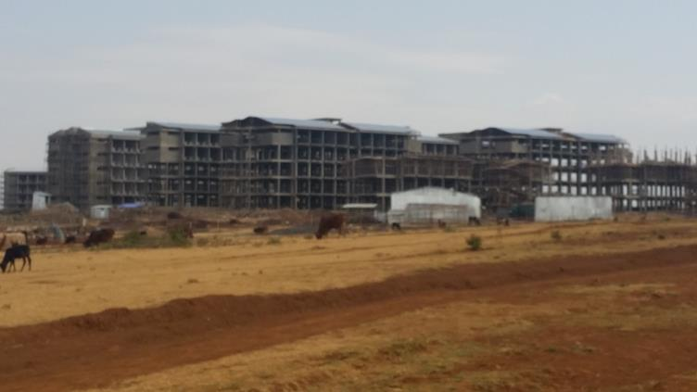
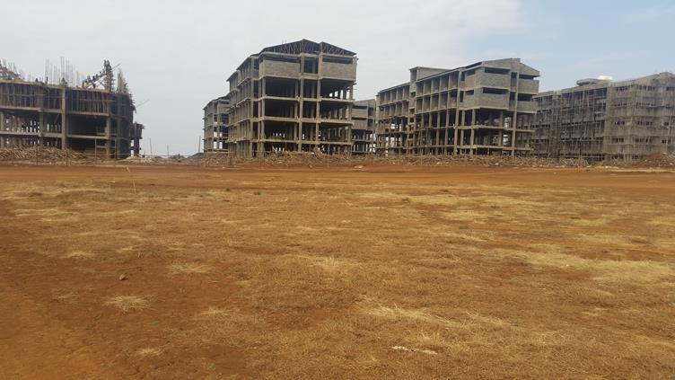
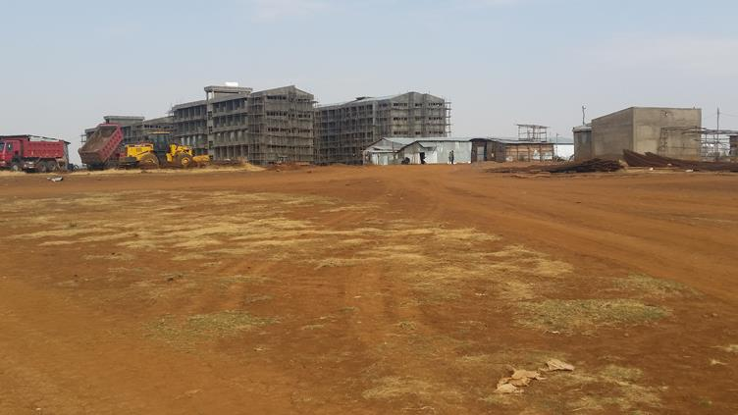
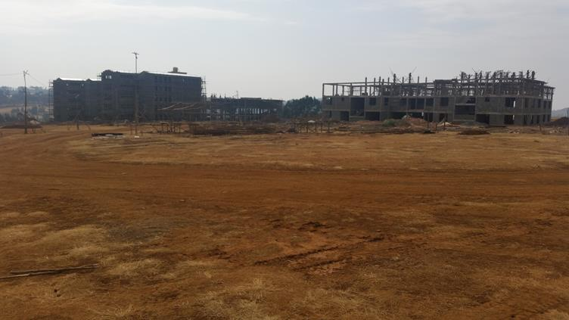
Public institutions

Slide 21
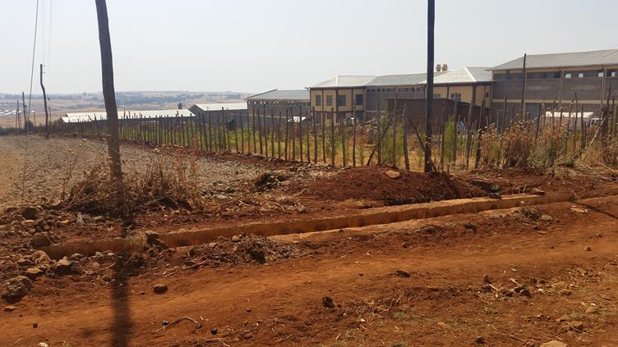
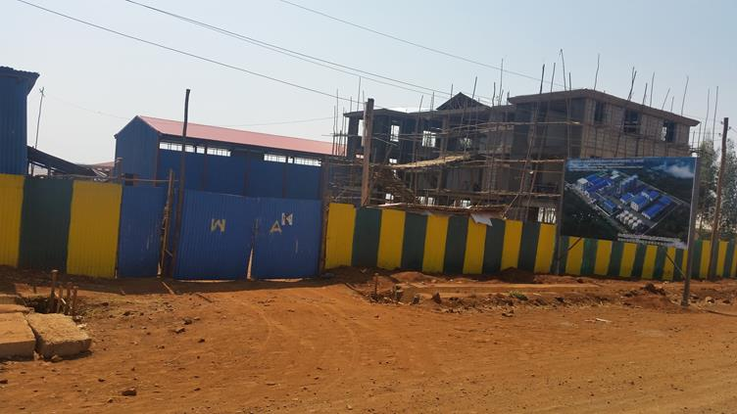
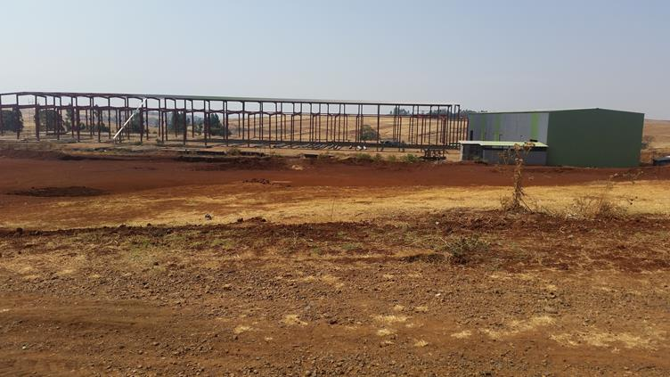
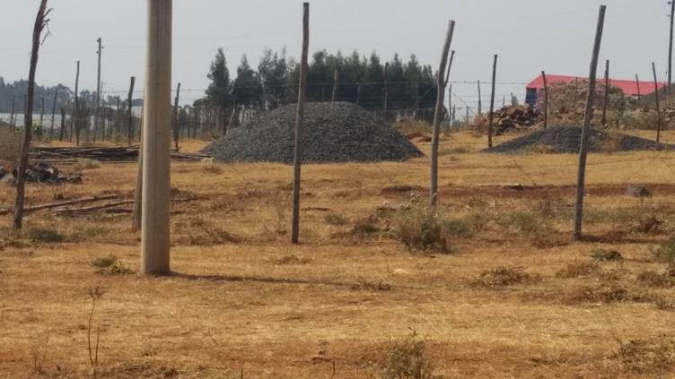
Industries

Slide 22
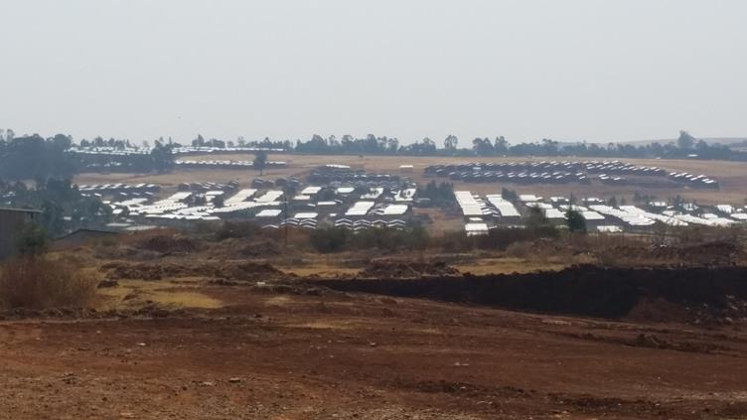
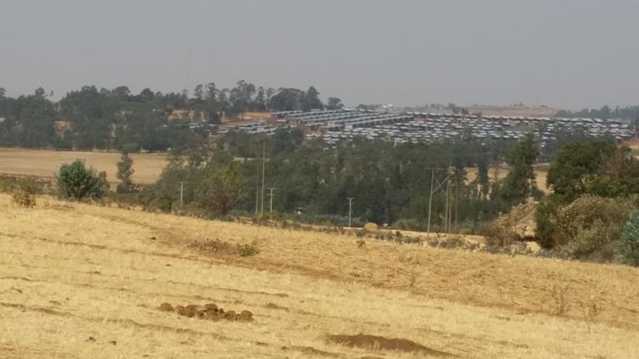
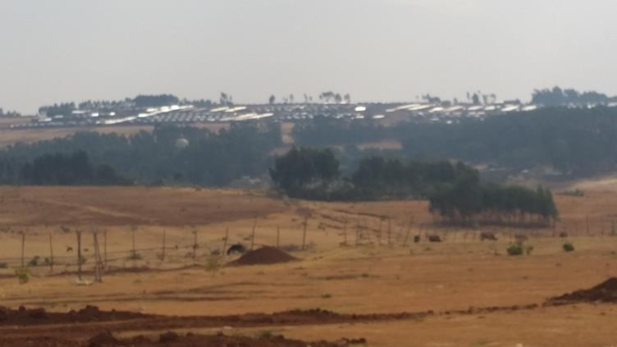
Residential

Slide 23
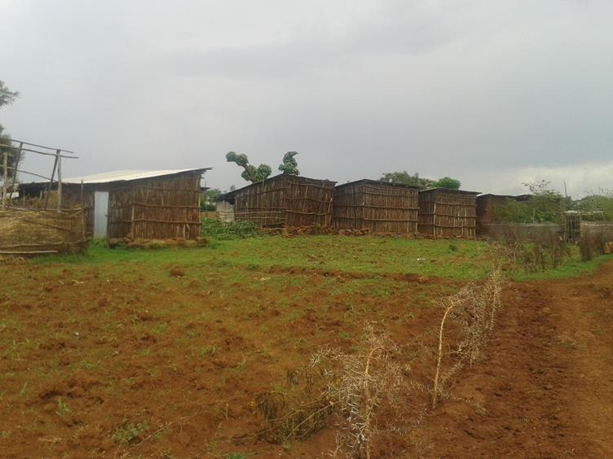
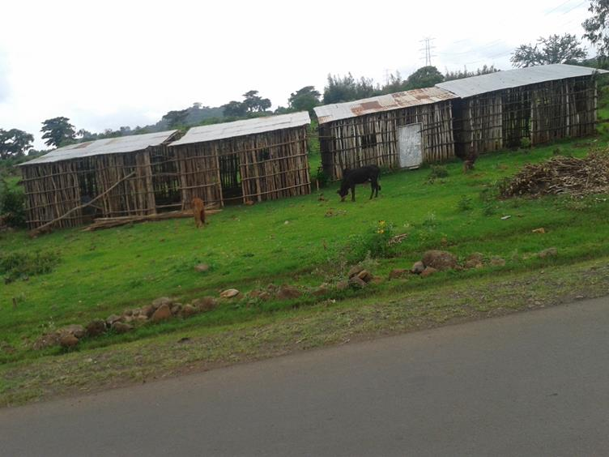
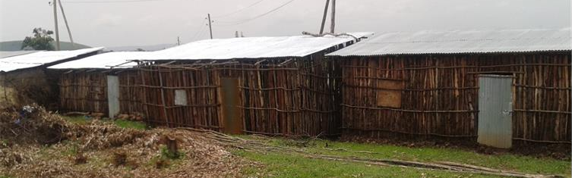
Illegal

Slide 24
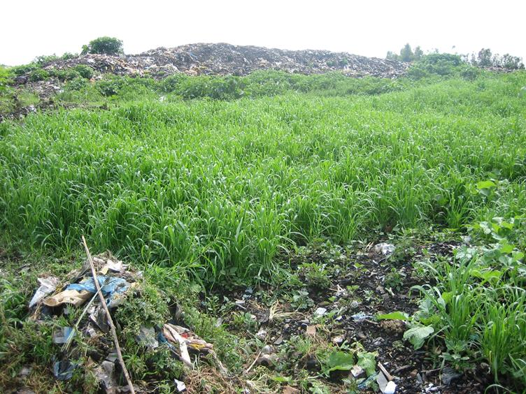
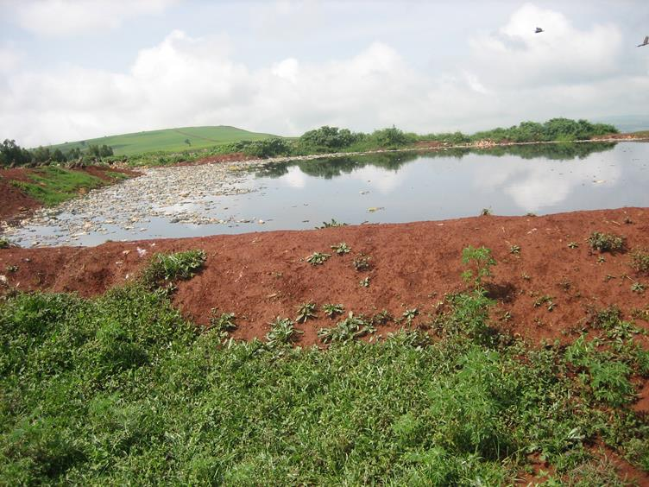
Waste disposal

Slide 25
Peri-urban land rights
To study peri-urban land right issues is essential
After having general overview of the peri-urban land rights, I decided to conduct study on “Urban Expansion and Peri-urban Land Tenure Security in Ethiopia”
Many problems but contextualized
  The state of urban expansion and peri-urban land rights
  The current expropriation and compensation practices
  The state of peri-urban land tenure disputes and resolution mechanisms

Slide 26
Peri-urban land rights
How to get fund and admission for my study was a challenge
The program is not delivered at home – abroad for admission
Application for scholarship competition to 4 western countries
One of these was APPEAR private scholarship
APPEAR was the first to award me scholarship support
I applied to BOKU for admission and the Institute of Surveying, Remote Sensing and Land Information admitted me for the PhD study
Thanking both the funding agency and the institute I started my study

Slide 27
Peri-urban land rights
Some important findings
Urban areas are expanding at high rates
The urban population is also steadily increasing
All peri-urban landholdings are not registered and titled
Lack of sense of tenure security
Lack of support for expropriated farmers in using their money
High incidence of peri-urban land disputes
  Between municipality and landholders
  Between developers and landholders
Policies for harmonized development of cities are needed

Slide 28
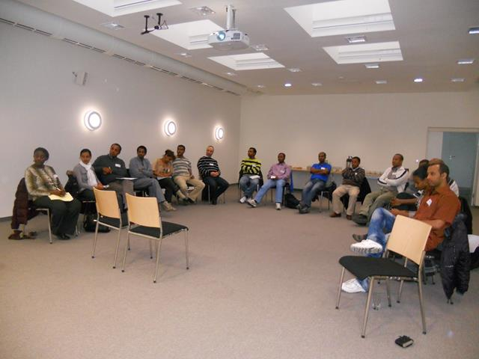
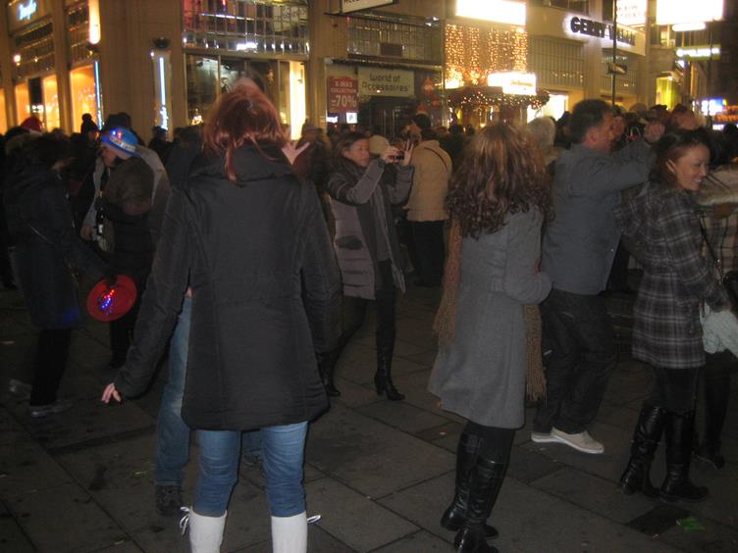
Cultural Exchange

Slide 29
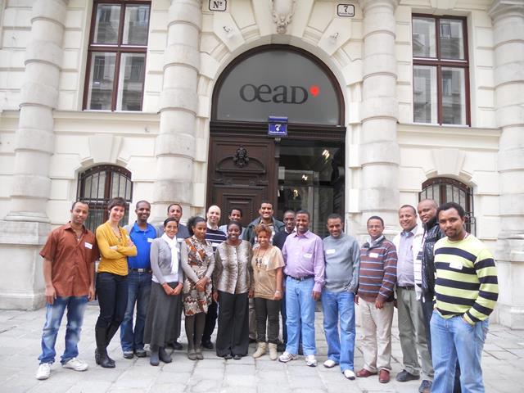

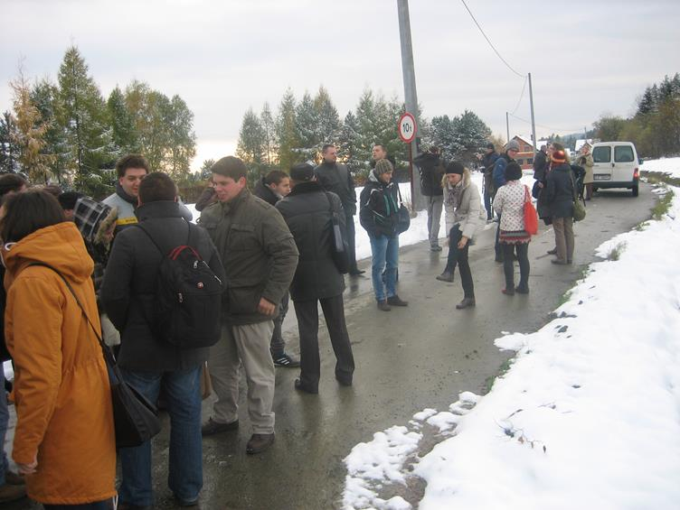

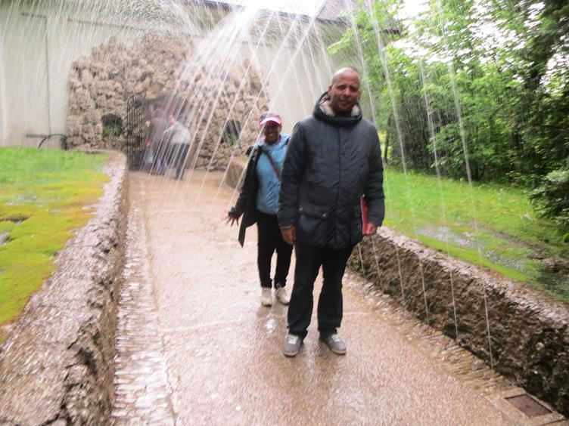
Cultural Exchange

Slide 30

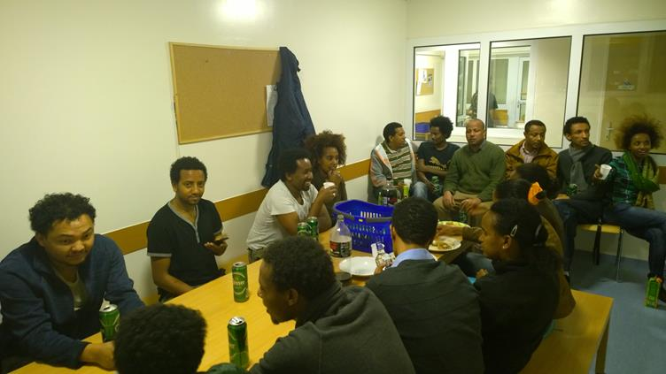

Slide 31
EduLAND2 – PROJECT 113

Slide 32
LAS
An effective land administration system (LAS) supports sustainability and is an essential source for decision making
LAS
  Land tenure
  Land use
  Land value
  Land development
It supports
  Sound and transparent land policy
  Resilient land use
  Spatial planning
  Sustainable land management

Slide 33
LAS
Effective land administration system is a prerequisite for good governance
One of the national priority needs of the country
Federal government and regional governments opened LA offices
United Nation studies suggested 50,000 professionals within the next 10 years
Cadastral surveying activities are being carried out
Financed by consortium ((World Bank, Finland, UK, EU, Norway, US, Germany and Austria)
Establishment of Institute of Land Administration (ILA)

Slide 34
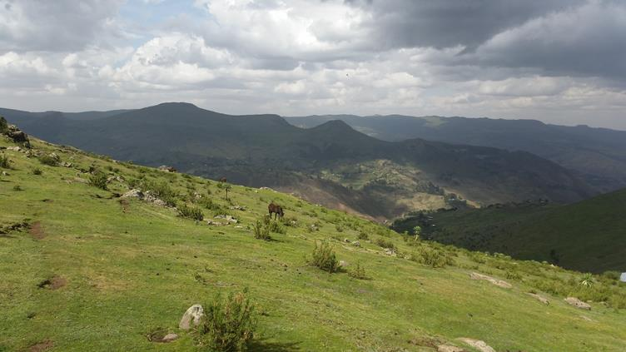
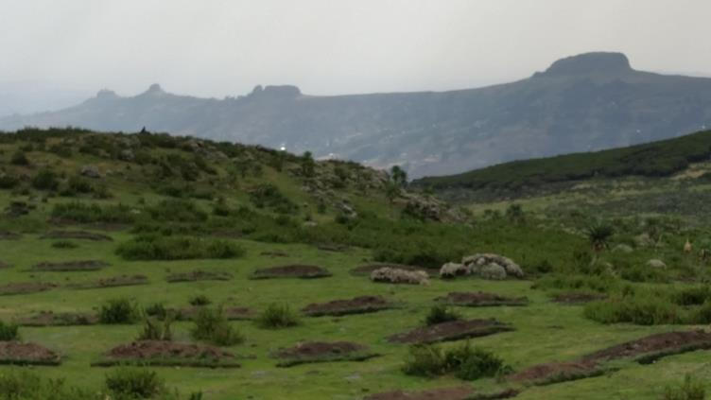
EduLAND2
Establish land administration competence center at Debre Markos University (DMU)
DMU
  300kms from Addis Abeba
  Foot of Choke mountain
  Has more than 30000 students
The academic partnership project on “Implementation of Academic Land Administration Education in Ethiopia for Supporting Sustainable Development”

Slide 35
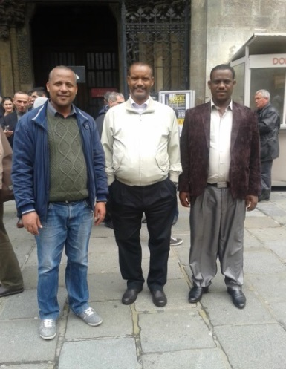
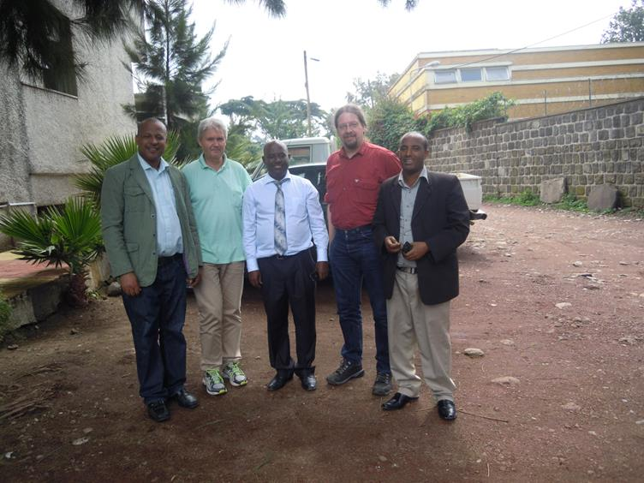
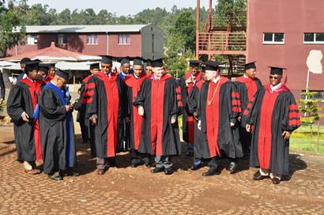
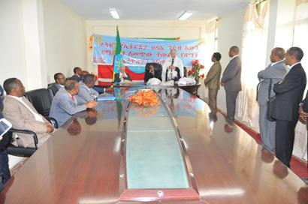
EduLAND2
Preparatory funding
Created partnership with two universities in Vienna (BOKU, TUW)

Slide 36
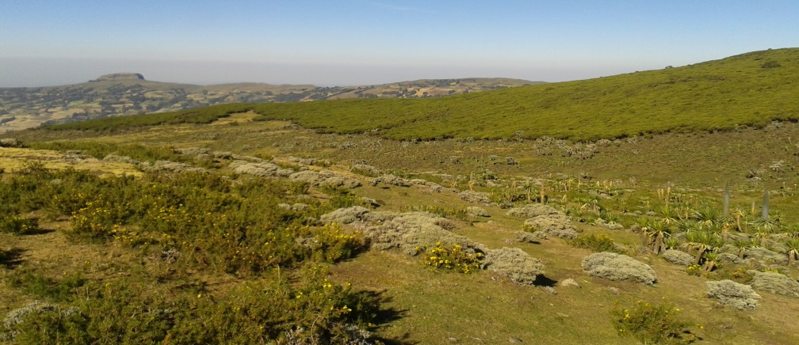
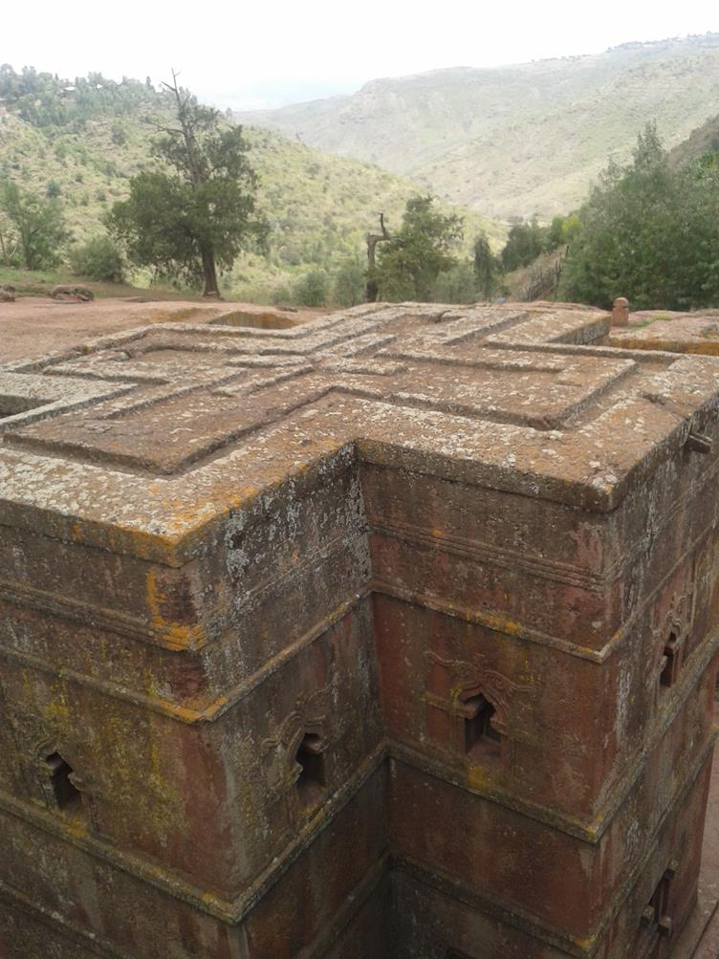
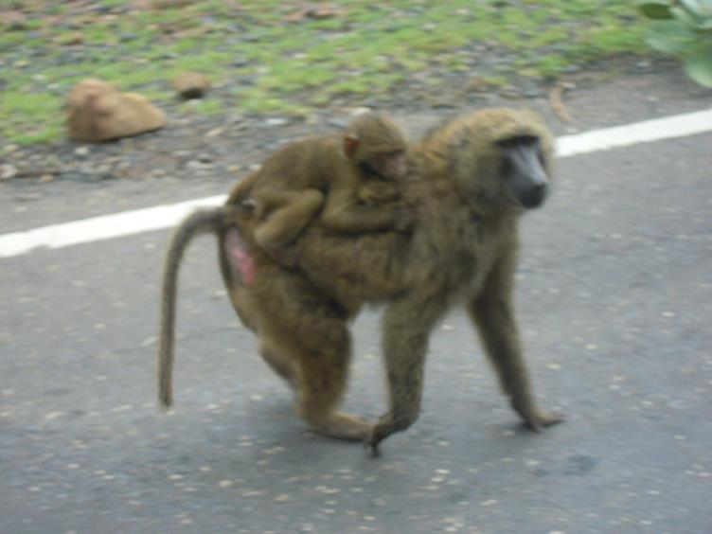
EduLAND2
Historical areas and NR

Slide 37
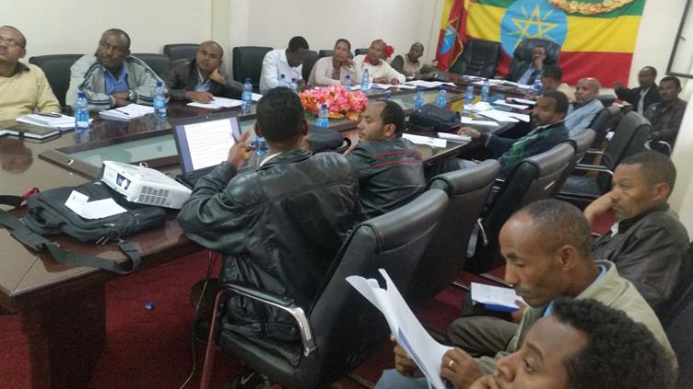
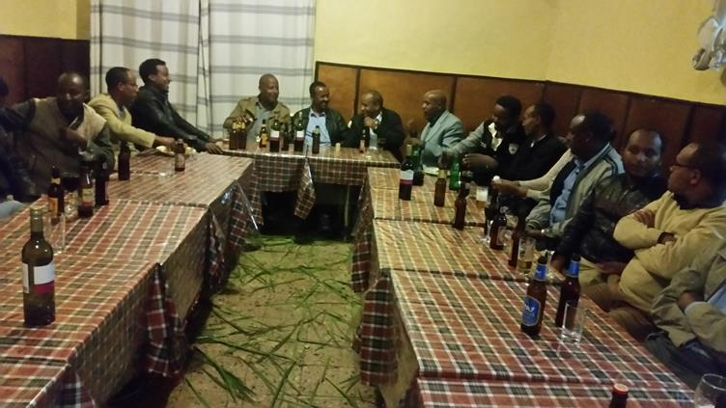
EduLAND2
About 418,231Euros
Need assessment
Institute of LA is officially launched in the University

Slide 38

EduLAND2
47 students are enrolled
About 70% are females
The computer lab is furnished
3 appear scholarships provided

Slide 39
Thanks for your attention!

